Slide 1

Topic 6 – Regression, Regularization, and Other Models
Data Science for Business
Prof: Chris Volinsky
NYU Stern: Fall 2024

Slide 2
Regression

Slide 3
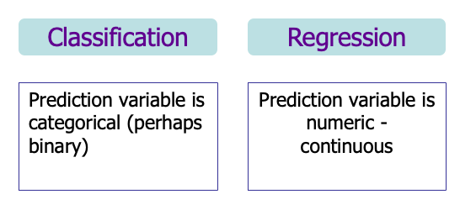
Regression models
Recall we categorize predictive models by the target
Decision Tree models are classification models
Now we focus on Regression models
Note: Logistic Regression is actually a classification model (more on that later)

Slide 4
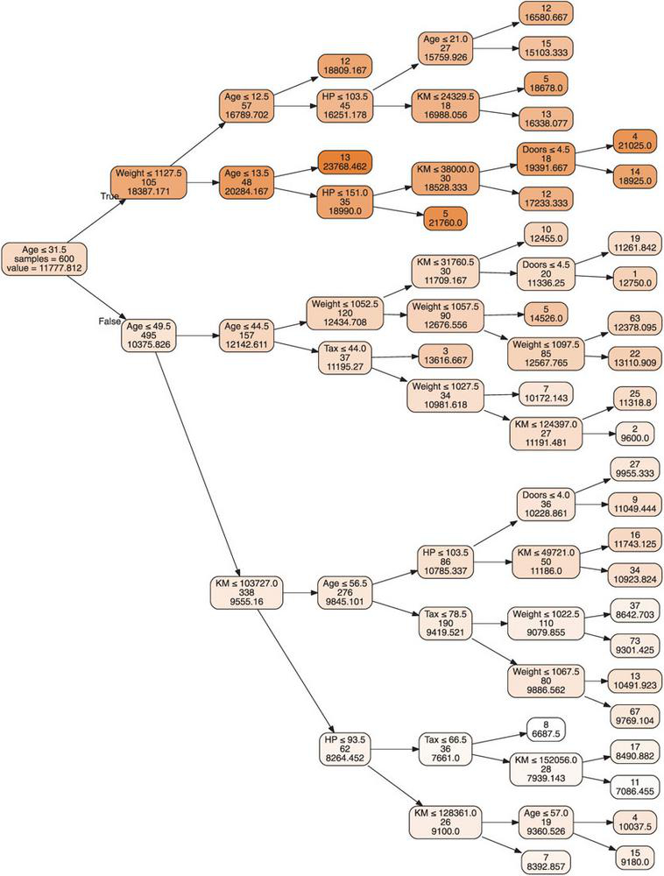
Regression Trees
Tree models can also be used with a numeric outcome, called Regression Trees
Purity is measured by the variance in the nodes
Prediction accuracy is measured by (root) mean squared error
Fitting process is similar to Classification Trees
Example: Predicting the price of used Toyota Corollas
From sklearn.tree import DecisionTreeRegressor
Shmueli: Chapter 9.6

Slide 5
Regression Trees and Grid Search
T6_RegressionTreeFit.ipynb

Slide 6

Linear Regression
Linear Regression is a mathematical optimization model to predict a numeric variable from one or multiple other variables
Can be numeric or categorical
Simple Linear Regression (SLR)
Only one explanatory variable (attributes)
Multiple Linear Regression (MLR)
Multiple explanatory variables (attributes)
Statistics: Focus is on parameter estimates, interpretations and significance
Data Science: Focus is on using the model for prediction
- assumptions for linearity, normality, etc, not as important
from sklearn.linear_model import LinearRegression
import statsmodels.formula.api as sm

Slide 7
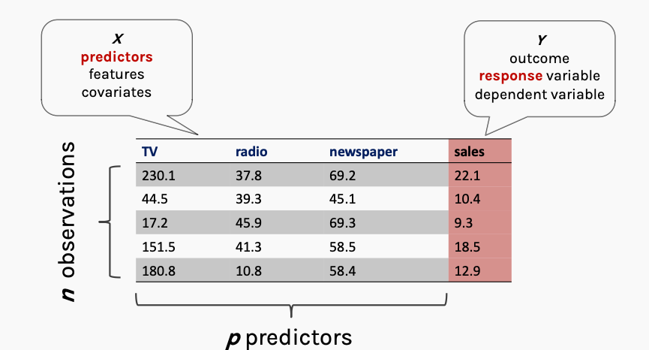
Advertising Data Example
X: thousands of $$
Y: thousands of units sold
Courtesy: Harvard IASC CS109A Protopapas

Slide 8
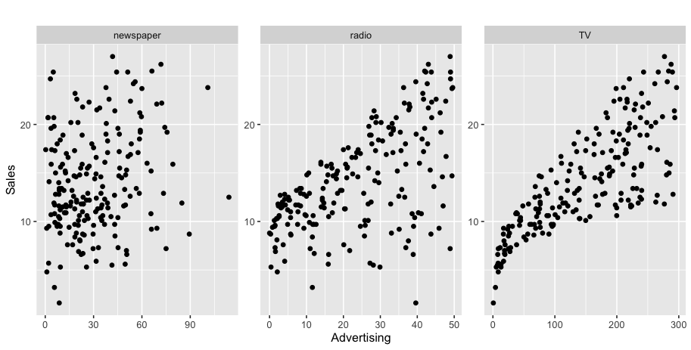
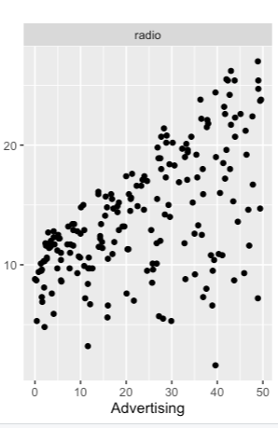
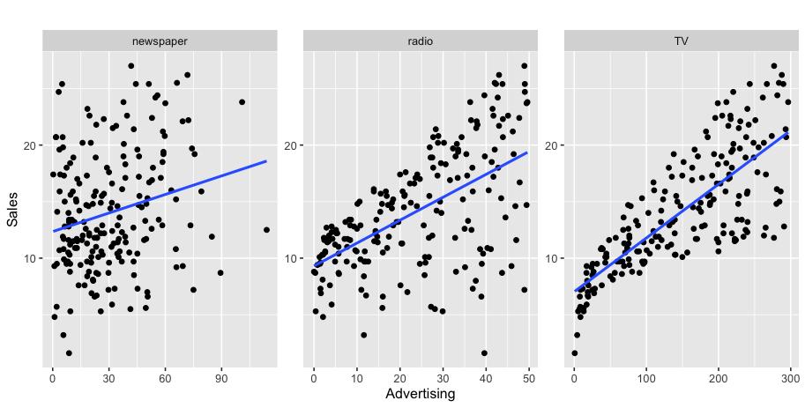
Regression Example – Advertising v Sales
k units sold
sales
$k
Is there a relationship between advertising and sales?
How strong is the relationship between different types of advertising and sales?
How accurately can we predict future sales?
Which media has the strongest connection to sales
Can do a simple regression for each one, or combine them into a multiple regression
Notes:
Advertising in different markets

Slide 9

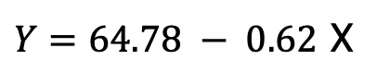
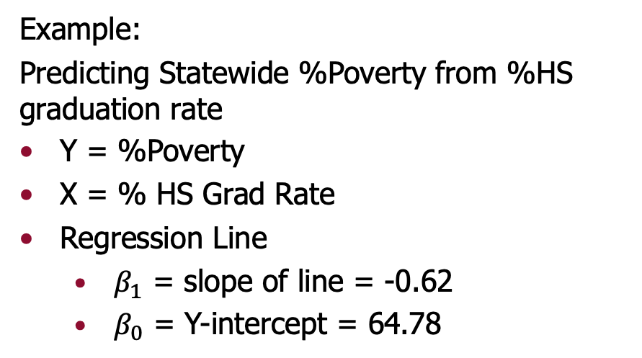
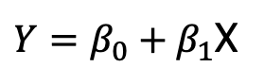
Defining the Regression Line
Any line is mathematically expressed as an equation with a slope and an intercept (you may have seen y=mx+b in algebra)
Regression Line Equation:
$Y=β_{0}+β_{1}$X
Example:
Predicting Statewide %Poverty from %HS graduation rate
Y = %Poverty
X = % HS Grad Rate
Regression Line
$β_{1}$ = slope of line = -0.62
$β_{0}$ = Y-intercept = 64.78
$Y=64.78 − 0.62$ X
negative slope= negative relationship =negative correlation

Slide 10
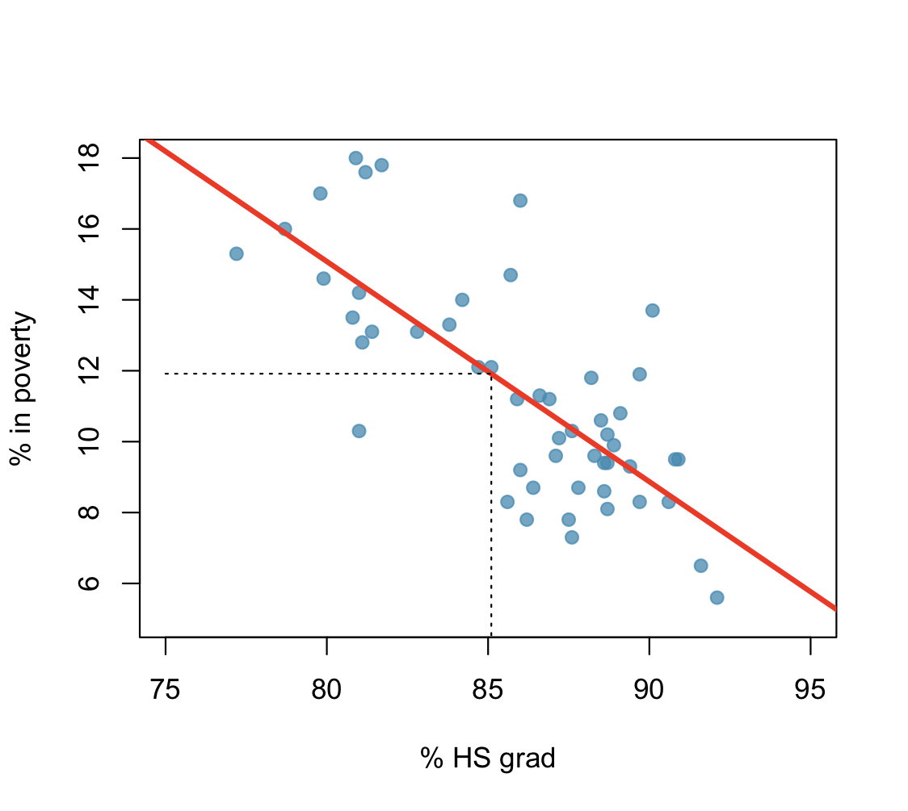
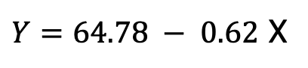
Regression line
$Y=64.78 − 0.62$ X
The high school graduation rate in Georgia is 85.1%. What poverty level does the model predict for this state?
Notes:
64.78 - 85.1x.62 = 12.02

Slide 11
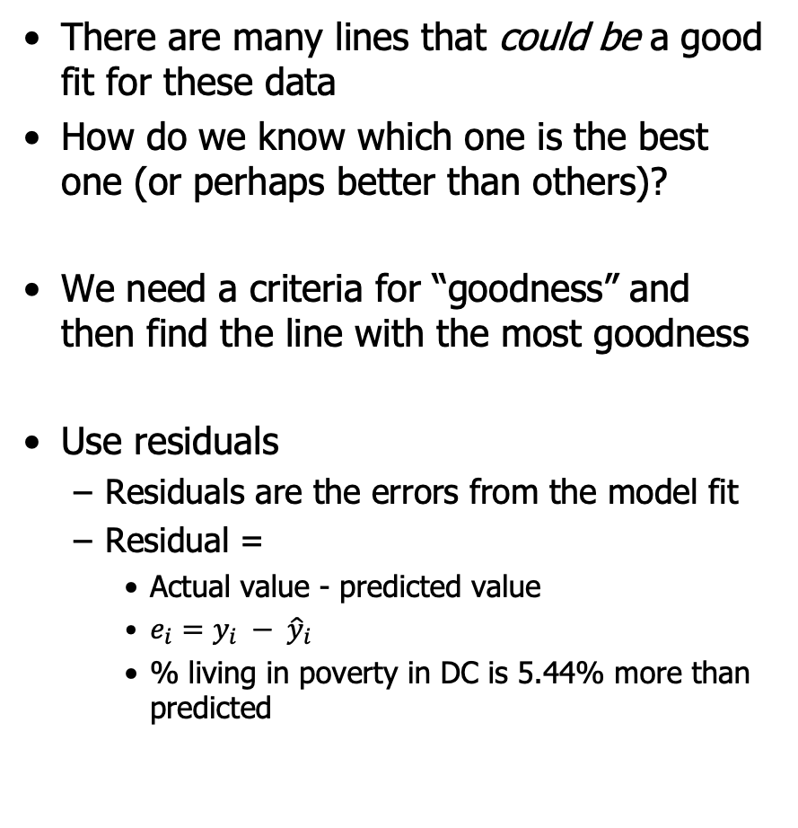
Finding the Right Regression Line
There are many lines that could be a good fit for these data
How do we know which one is the best one (or perhaps better than others)?
We need a criteria for “goodness” and then find the line with the most goodness
Use residuals
Residuals are the errors from the model fit
Residual =
Actual value - predicted value
$e_{i}=y_{i} − {\hat{y}}_{i}$
% living in poverty in DC is 5.44% more than predicted

Slide 12
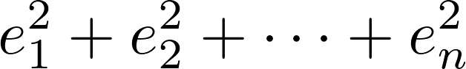
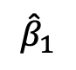
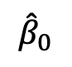
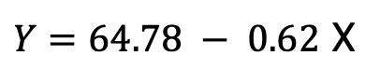

Least Squares Regression Line
The least squares regression line is the line that minimizes the sum of the squared residuals
Squares? This makes sure errors don’t cancel out
aka: mean squared error
Regression functions mathematically find the line that minimizes sum of squared residuals
Return estimates ${\hat{β}}_{0} and{ \hat{β}}_{1}$
$Y=64.78 − 0.62$ X
$${\hat{β}}_{0}$$
$${\hat{β}}_{1}$$

Slide 13
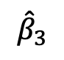
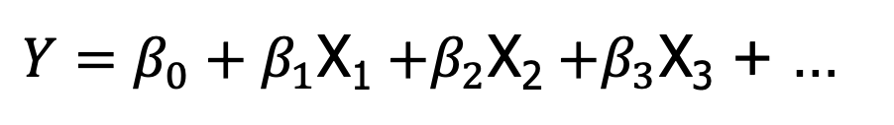
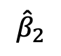
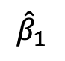
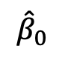
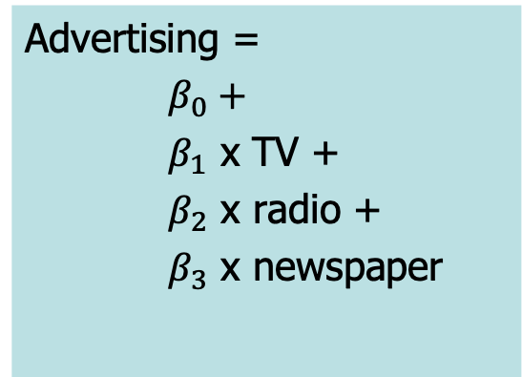
Multiple Regression Model
Our regression line equation defines the relationship between the random variables:
$Y=β_{0}+β_{1}$X₁ $+β_{2}$X₂ $+β_{3}$X₃ + …
Advertising =
$β_{0}+$
$β_{1}$ x TV +
$β_{2}$ x radio +
$β_{3}$ x newspaper
Sales = 2.94 + 0.04 TV + 0.18 radio + 0.01 newspaper
$${\hat{β}}_{0}$$
$${\hat{β}}_{1}$$
$${\hat{β}}_{2}$$
$${\hat{β}}_{3}$$
Notes:
What is the prediction for a market that spends 10k on each
2.94 + 0.46+1.89 – 0.01 = 5.28 k units sold

Slide 14
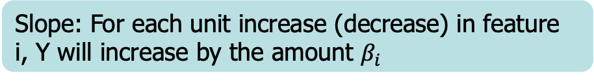

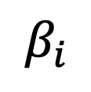
Linear Regression - Statistics
$$β_{0}$$
Intercept: The value of Y when all Xs =0
$$β_{i}$$
Slope: For each unit increase (decrease) in feature i, Y will increase by the amount $β_{i}$
How many standard deviations this value is away from zero, a measure of importance or significance
t-statistic
Probability of seeing this result if there is really no effect. Low p-value (p<0.05) means evidence of significance.
P-value
R²
Percent variance explained by regression (between 0 and 1)

Slide 15
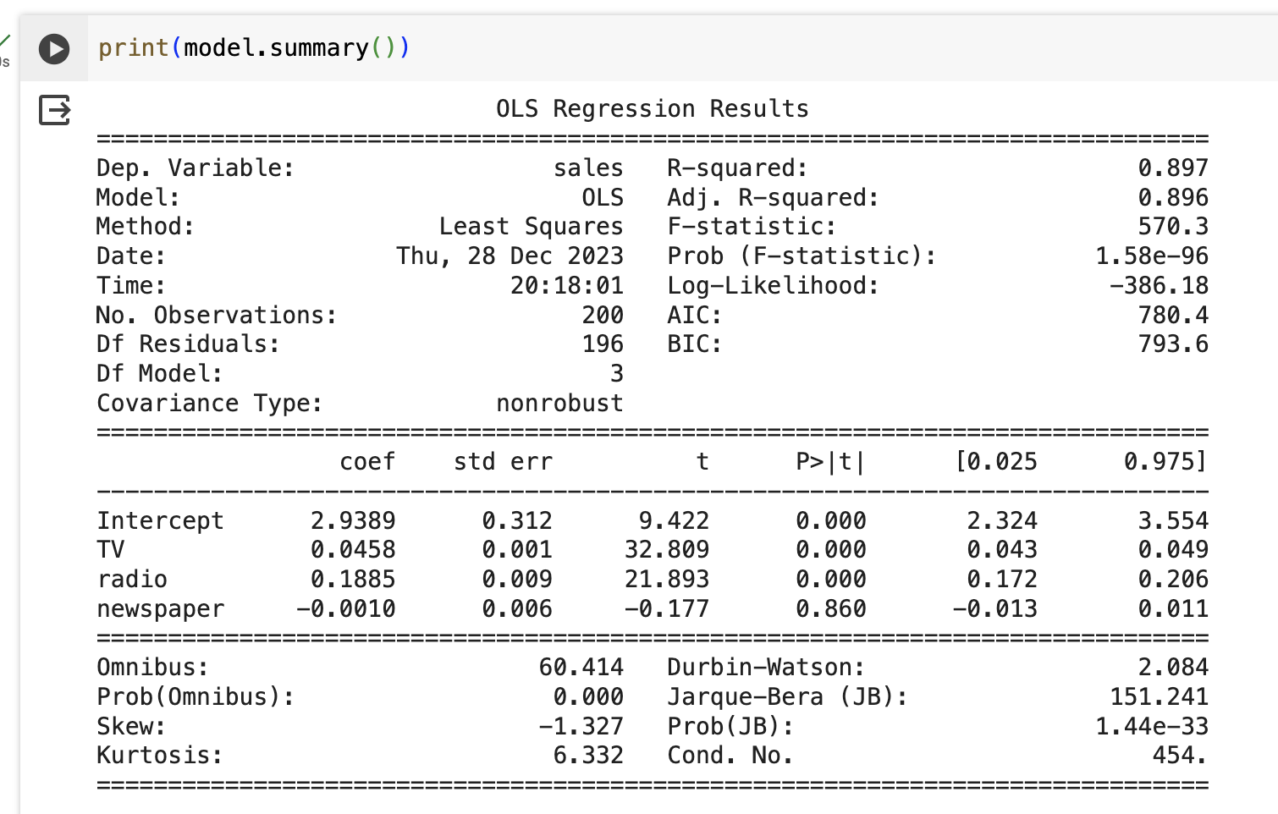
Regression output - python
Using statsmodels
How good is the model? You might be familiar with these but..
R² and Adjusted R² are measures on the training set 😮
The t-stat and the p-value tell us which features are most important
Can use .fit and .predict just like any other model
Notes:
What is the equation???
What is the prediction for a market that spends 10k on each
2.94 + 0.46+1.89 – 0.01 = 5.28 k units sold

Slide 16
Regression - Complexity
One simple way to balance complexity and performance in linear regression…
Simply remove the features that have significance p<0.05
Remove and refit

Slide 17
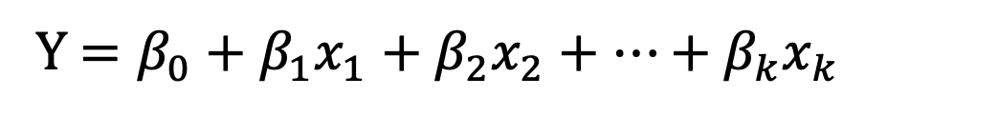
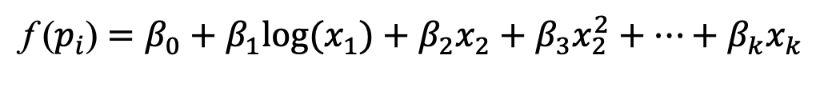
Extending Regression: Non-linear regression models
Linear regression is, um, linear in the features
Y $=β_{0}+β_{1}x_{1}+β_{2}x_{2}+⋯+β_{k}x_{k}$
But maybe you have seen through exploratory analysis that the relationship does not seem to be linear
One “trick” to do this, is to keep a linear model, but transform the predictor:
Logarithmic
Square or other polynomial
f ($p_{i}$) $=β_{0}+β_{1}{log(x}_{1})+β_{2}x_{2}+β_{3}x_{2}^{2}+⋯+β_{k}x_{k}$
This adds complexity to the model and may cause overfitting…
Notes:
You can fit any model perfectly

Slide 18
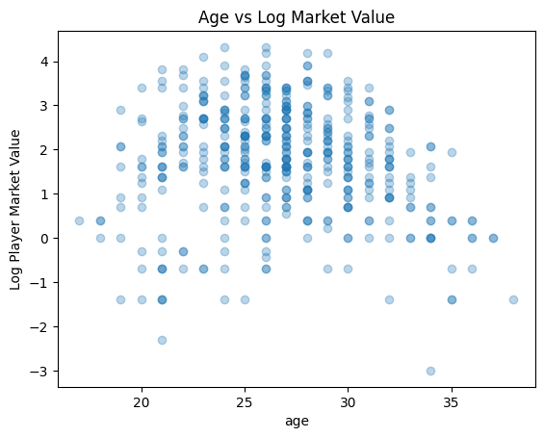
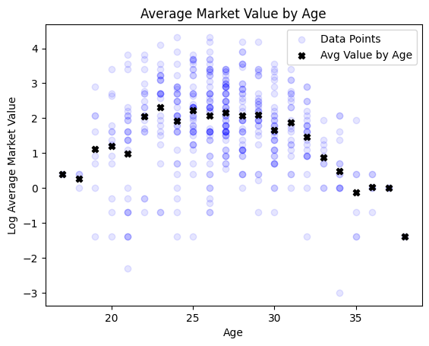
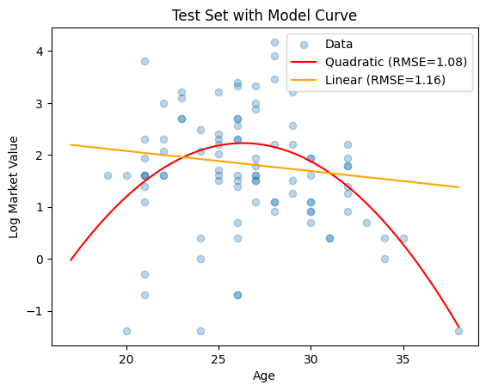
Add polynomials where needed
English Premier Soccer Data
Market Value vs. Age…

Slide 19
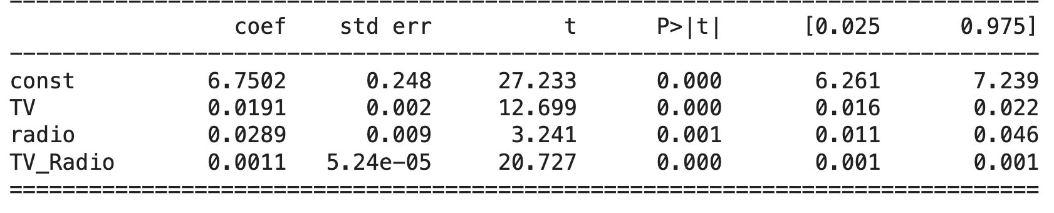

Interaction Terms
The Linear regression model assumes that all effects are independent and linear
The effect of one feature does not depend on the value of another
Not always true!
Interaction terms can account for these dependencies
ad["TV_Radio"]=ad["TV"]*ad["radio"]
Be careful, adding interactions can really explode your feature space
Notes:
Maybe advertsing on radio helps make the TV advertising even more effective because of the awareness….

Slide 20
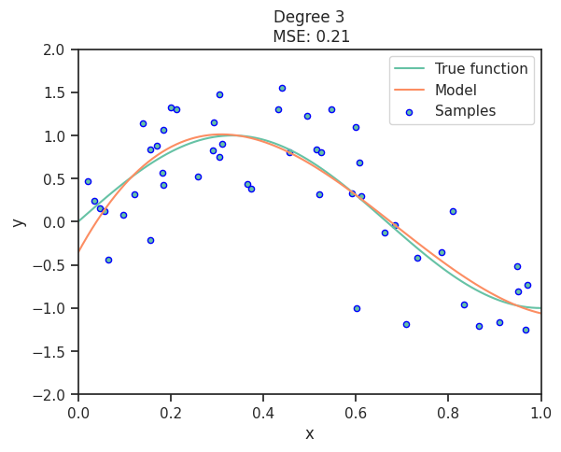
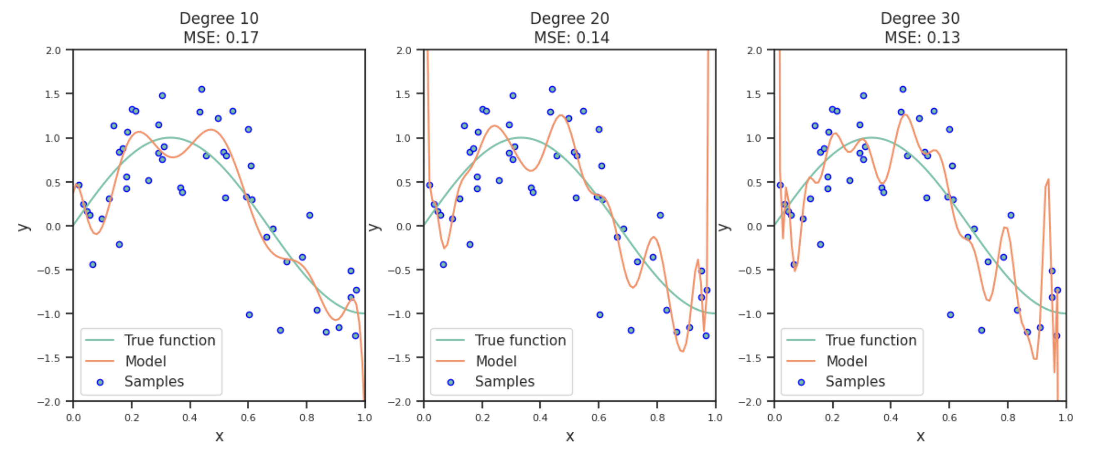
Recall, complexity always improves fit on the training data, but does not extend to the hold out data

Slide 21
Logistic Regression

Slide 22

Logistic Regression
Logistic Regression is a bit of a misnomer
It is actually a technique for Classification
Typically with a binary response
But: it uses a clever transformation of the binary response so it can use the same techniques as linear regression
Used for binary prediction and estimating probabilities
from sklearn.linear_model import LogisticRegression

Slide 23
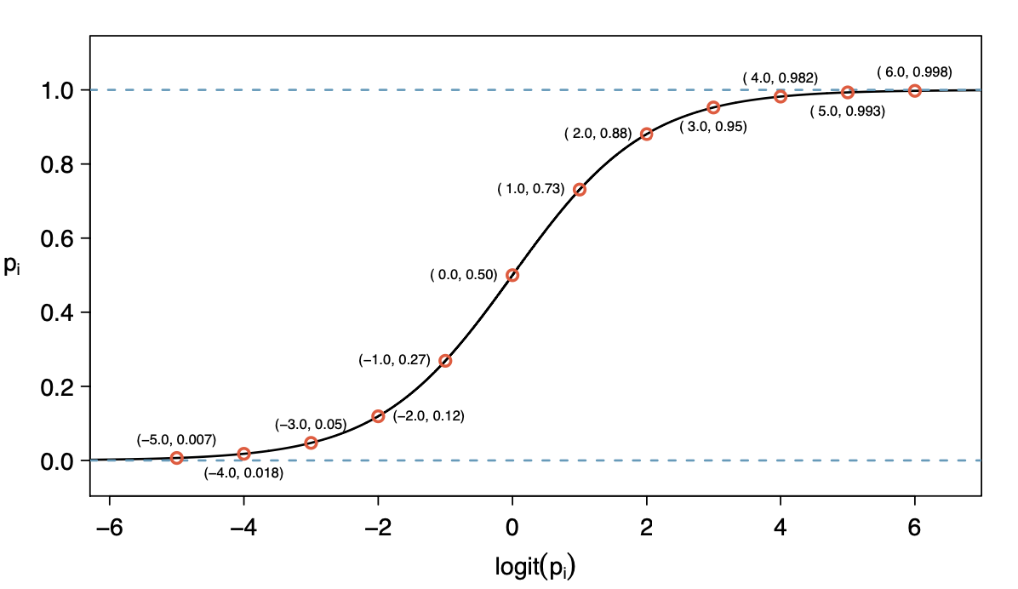
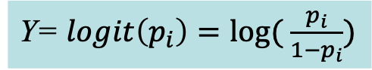
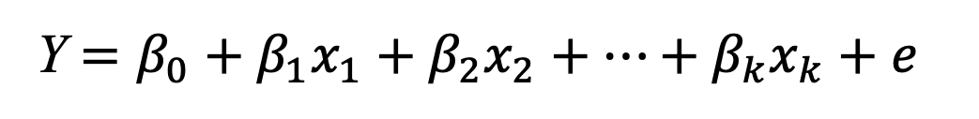
Logistic Regression
Instead of trying to predict the binary target directly, Logistic Regression directly predicts the probability of a “success” (or whatever the value of 1 represents).
Model:
Y $=β_{0}+β_{1}x_{1}+β_{2}x_{2}+⋯+β_{k}x_{k}+e$
Y= $logit\left(p_{i}\right)=log⁡( \frac{p_{i}}{1−p_{i}})$
Logistic regression is interpreted the same way as linear (except for β_{ι})
Notes:
Its hard to fit a model that just “stops” at 0 or 1, so logistic regression was a mathematical trick invented to allow the model to estimate a number that can take on any value, but map it to a probability.
Beta_i is NOT interpreted as a change in Y for every unit change in X. Technically beta refers to the “log-odds” of the feature, which is the ration of the log(prob(Y=1)/prob(Y=0))

Slide 24
Complexity and Overfitting in Regression

Slide 25
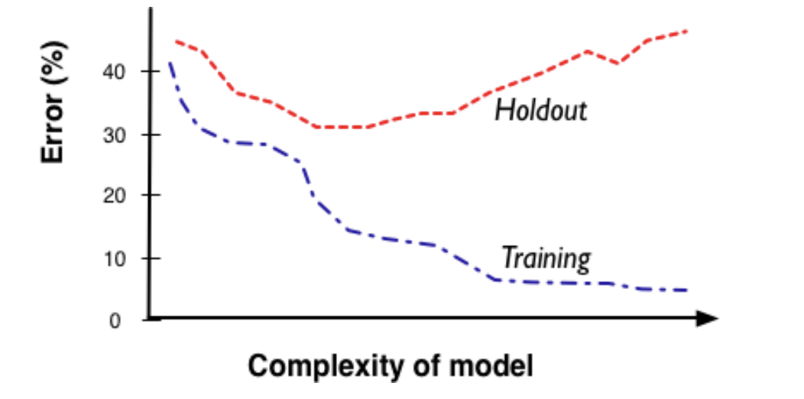
Complexity
Remember the complexity conundrum
More complexity allows us more freedom and flexibility to fit the messy realities
BUT higher complexity runs the risk of overfitting data

Slide 26


Complexity in Regression
For regression models, complexity comes in multiple forms – often called the “dimensionality” of the model
Number of attributes
More attributes means more complex relationships
Categorical variables can explode dimensionality (remember one-hot encoding)
Functional form of the regression
Degree of polynomial
Interaction between features
In general we want to follow “Occam’s Razor”
Keep the model as simple as possible while maintaining predictive performance
Adding attributes might make our model better!
But now we’ve added complexity and might be overfitting

Slide 27
Complexity in Regression
There are real-world scenarios where we may want to explore hundreds, thousands, even MILLIONS of attributes
Recommender Systems
Web-based marketing models
Financial models with time based attributes

Slide 28
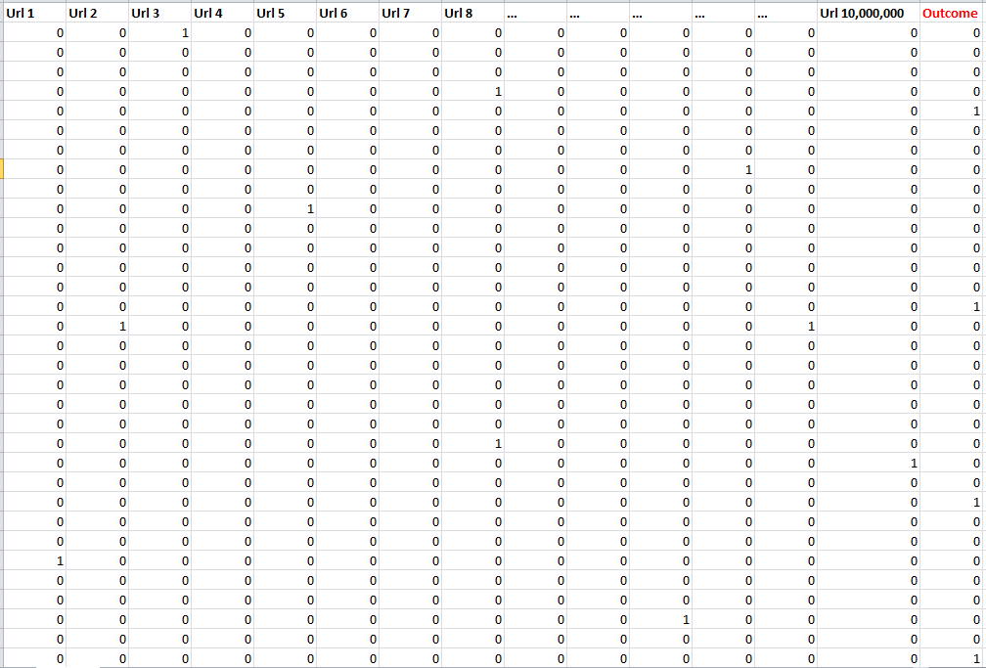
A real example….
10 Million Columns
1-50K Positives
Notes:
Predicting who is going to click on an ad…

Slide 29
Complexity in Regression
Two ways to reduce complexity when you have a HUGE number of features
Reduce the number of attributes (see next chapter)
Variable Selection, clustering, principal components
2) Use a penalty in the objective function
regularization : One weird trick to address complexity

Slide 30

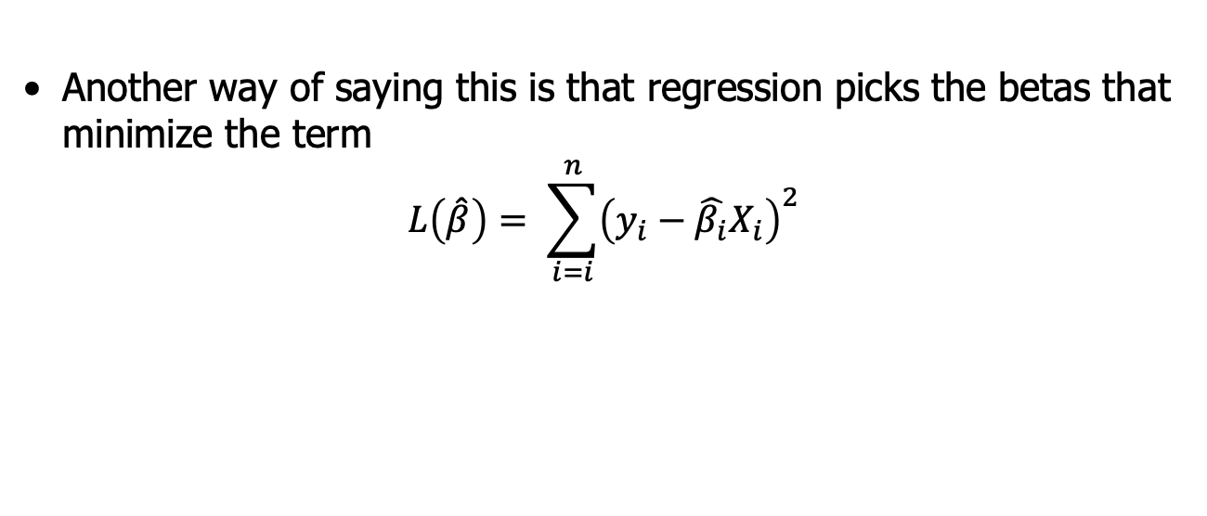
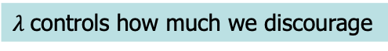
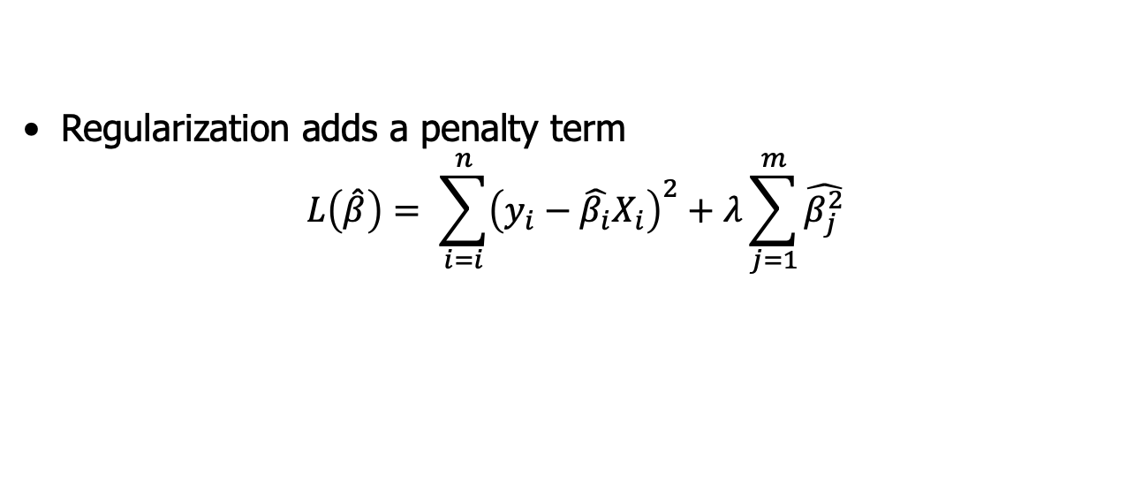
Regularized Regression
Recall how we find the best regression line
The least squares regression line is the line that minimizes the sum of the squared residuals
Another way of saying this is that regression picks the betas that minimize the term
$$L\left(\hat{β}\right)= \sum_{i=i}^{n}{{\left(y_{i}−\hat{β_{i}}X_{i}\right)}^{2}}$$
Regularization adds a penalty term
$$L\left(\hat{β}\right)= \sum_{i=i}^{n}{{\left(y_{i}−\hat{β_{i}}X_{i}\right)}^{2}+λ\sum_{j=1}^{m}{\hat{β_{j}^{2}}}}$$
Discourages extreme or overfit values in model parameters
$λ$controls how much we discourage

Slide 31
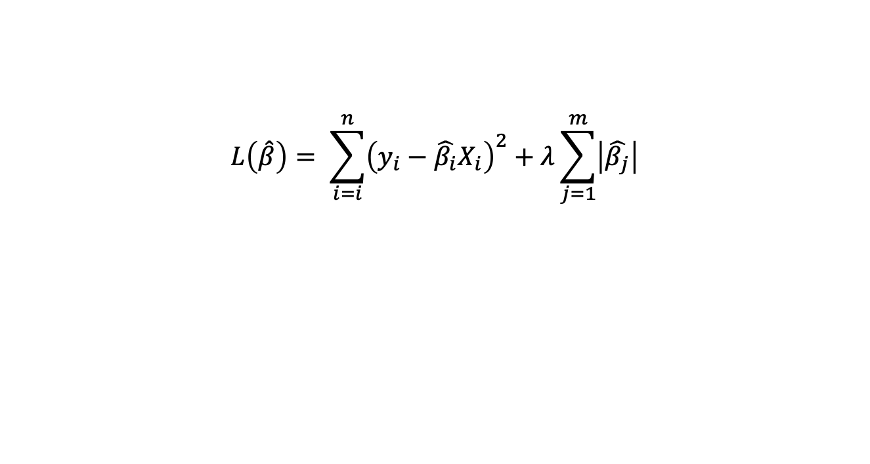
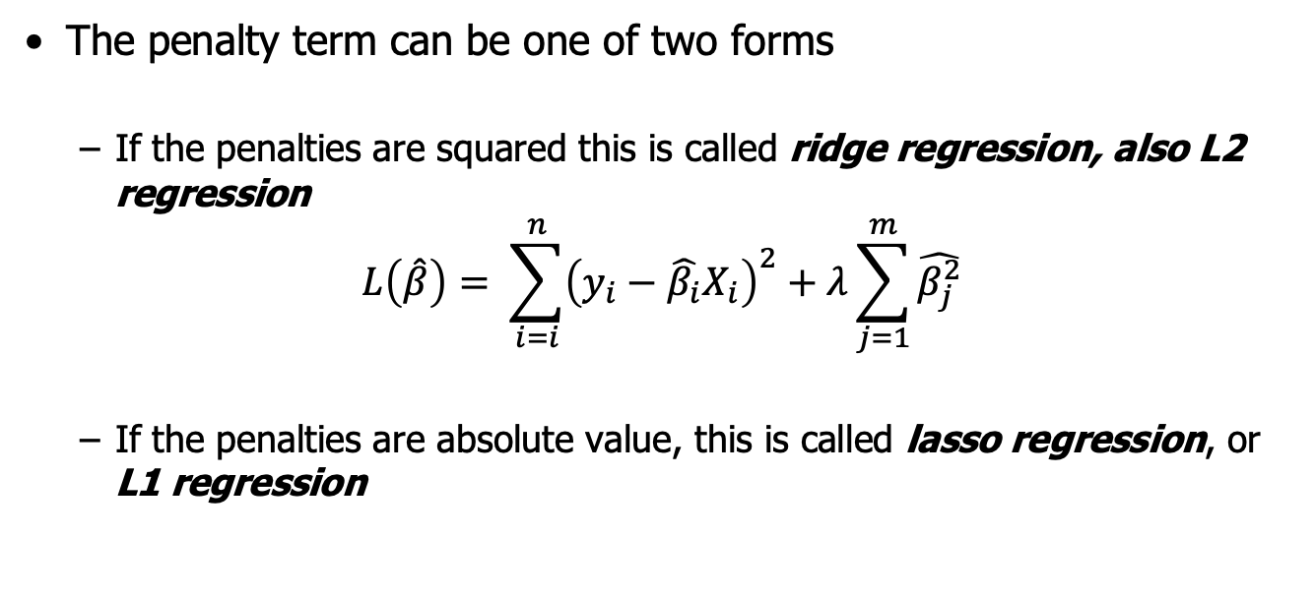
Regularized Regression
The penalty term can be one of two forms
If the penalties are squared this is called ridge regression, also L2 regression
$$L\left(\hat{β}\right)= \sum_{i=i}^{n}{{\left(y_{i}−\hat{β_{i}}X_{i}\right)}^{2}+λ\sum_{j=1}^{m}{\hat{β_{j}^{2}}}}$$
If the penalties are absolute value, this is called lasso regression, or L1 regression
“ridge penalty”
$$L\left(\hat{β}\right)= \sum_{i=i}^{n}{{\left(y_{i}−\hat{β_{i}}X_{i}\right)}^{2}+λ\sum_{j=1}^{m}{\left|\hat{β_{j}}\right|}}$$
“lasso penalty”
The typical result of the penalty is to “shrink” the β parameters towards zero
This shrinking of the coefficient value corrects for overfitting
Can be done for up to millions of features!
Regularization is also often referred to as shrinkage

Slide 32

Key points about Regularized Regression
Regularized regression can be used when you have many features and don’t have a good way of reducing the total amount
Two types of regularization:
Ridge: uses squared penalty (L2)
Lasso: uses absolute penalty (L1)
Single parameter lambda (λ) determines the amount of regularization
λ = 0 means no regularization
Larger λ is stronger penalty
λ can be determined by test set or cross-validation
Cannot directly measure “significance” of coefficient with Lasso/Ridge
How much the coef is shrunk towards zero is a proxy for significance
sklearn.linear_model.Lasso
sklearn.linear_model.Ridge
Note: Uses alpha instead of lambda 🤷

Slide 33
Regularized Logistic Regression
Lasso and Ridge regularization can be run with logistic regression
model_lr = LogisticRegression(C=100000)
“C” is the complexity parameter and = 1/lambda
Large C means no regularization
For lasso use penalty=‘l1’
We mentioned that the lasso will “shrink” parameter estimates towards zero
In the lasso case, it will force some of the coefficients to equal exactly zero
This ends up having the same effect as variable selection!
Lasso is very popular and tends to be quite effective while creating a much simpler model.
More details: ISL Chapter 6.2

Slide 34
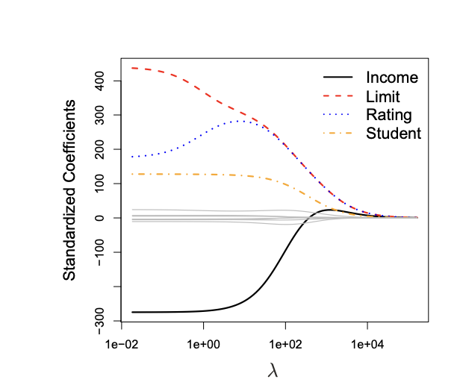
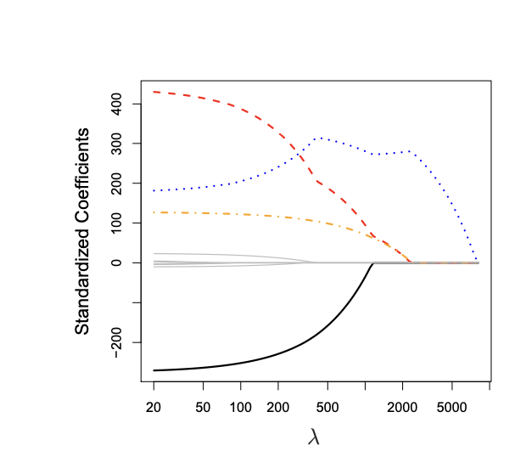
Lasso v. Ridge Shrinkage

Slide 35

Regularization Uses
Regularization has many uses in data science
Shrinks parameter values to avoid overfitting
Removes noise features by setting parameter value to 0 (lasso)
Can help deal with heavily correlated features (multicollinearity)
Can enable fitting massive amounts of features (high dimensionality)
Can fit models where you have more parameters than observations (p>n)
Notes:
Stabilizes the matrix
ML engineers love it

Slide 36
Regularization
T6_Regression_Regularization.ipynb

Slide 37
Mathematical Classification

Slide 38
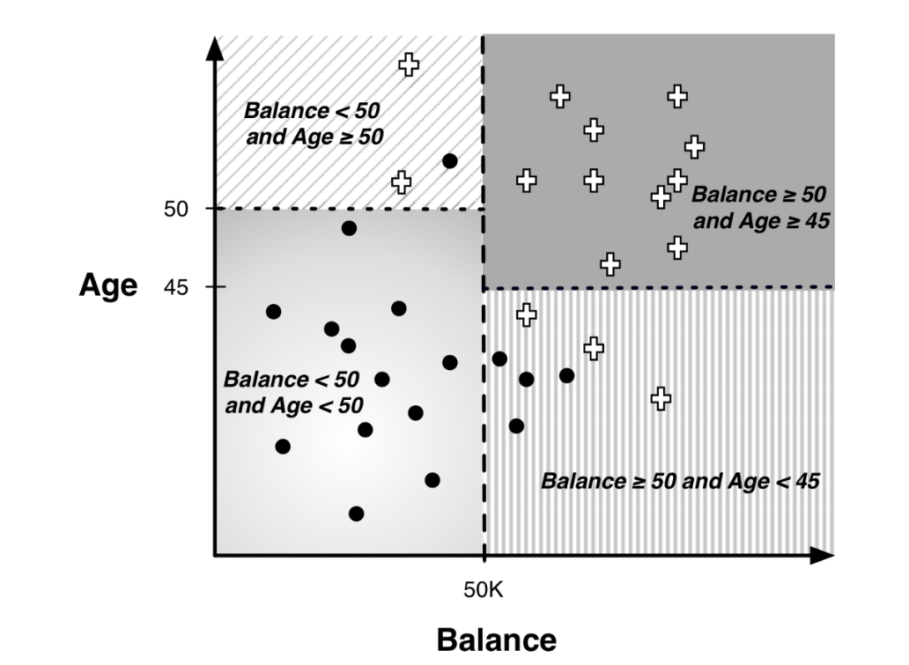
Mathematical Classification
Trees are a “rule-based” way to build classification models
Results in a partition of the input space
Uses rules that are parallel to axes:

Slide 39
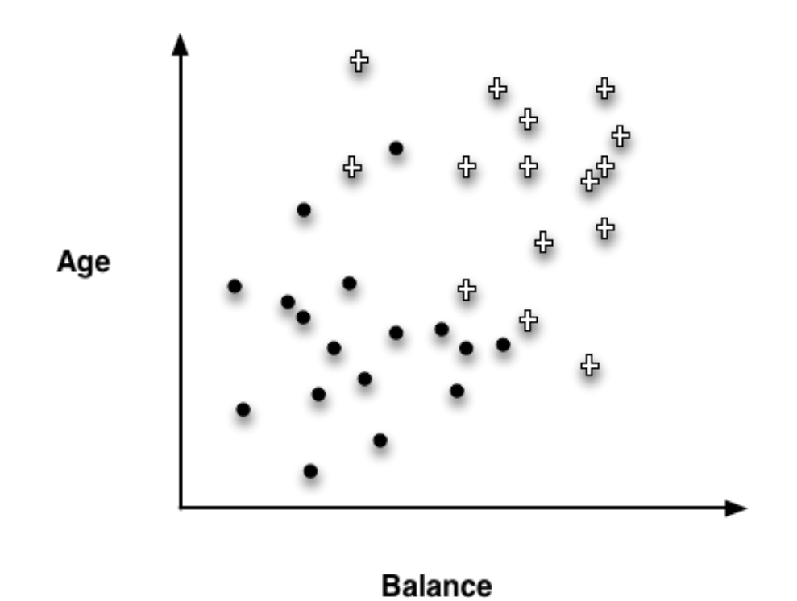
Mathematical Classification
Can you think of another way to separate these data?

Slide 40
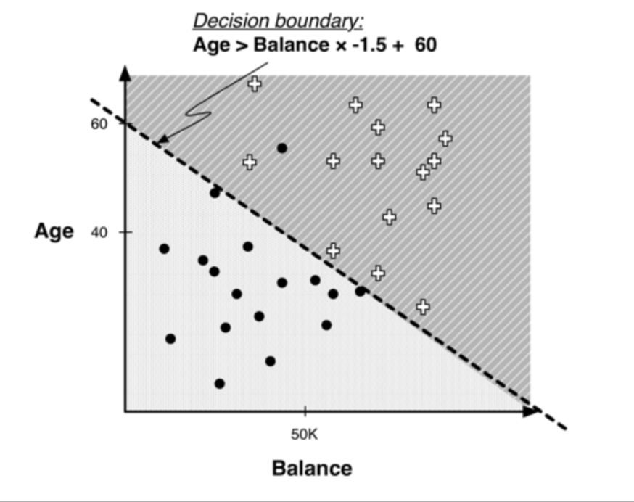
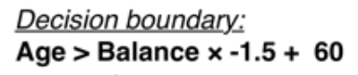
Linear Classification via Discriminants
Linear Discriminant model
vs
“best” line is found via mathematical optimization
This is NOT regression!

Slide 41

Linear Discriminant Models
Linear discriminant:
+ if 1.0×𝐴𝑔𝑒 −1.5×𝐵𝑎𝑙𝑎𝑛𝑐𝑒+ 60 > 0
Class(x) =
$∘$ if 1.0×𝐴𝑔𝑒 −1.5×𝐵𝑎𝑙𝑎𝑛𝑐𝑒+ 60 $≤$0
Linear discriminants:
Are a parameterized model: the coefficients of the line are determined by the algorithm
Competing model to logistic regression
Both are linear in the features
Good when
You believe the relationship might be linear
Feature distributions are “well-behaved” (normal)
from sklearn.discriminant_analysis import LinearDiscriminantAnalysis

Slide 42
Support Vector Machines

Slide 43

Classification via Support Vector Machines
Support Vector Machines are another type of mathematical model that finds linear boundaries between classes
They have become quite popular in recent years due to their superior performance in classification problems.
Which line is best?

Slide 44

Which line is best?
Simplifying assumption: points are separable
Prefer the one with the most space in between?
How would you measure this?

Slide 45

Maximizing margin: support vector machine (SVM)
The optimal SVM is the boundary that maximizes the margin
Of course data is not typically separable, but there are some clever mathematical tricks devised to deal with that
Computationally complex, but
from sklearn import svm
SVM has complexity parameters:
C : “the cost”: higher values fit training data more closely
Kernel: linear or non-linear + degree of polynomial
ISL: Chapter 9.3 – 9.6 has good explanation plus python code
Notes:
Imagine separating h v l value
On age and income
H and V not separable,
But you can unlock a third feature, customer loyalty that allows one to separate.
That is what the “kernel trick” does.l

Slide 46

SVM in Predictive Modelling
SVMs provide some of the best predictive performance
Can find boundaries in complex, non-linear situations
But:
Very computationally intensive
Need to standardize features
Many tuning parameters

Slide 47
Time Series and Forecasting

Slide 48
Time Series or Forecasting
Modelling data with a time component requires some specialized thinking
This field is called Time Series – when the goal is prediction it is often callsed Forecasting
Used widely to forecast sales, markets, production, demand, etc
Can be at any granularity, year, month, day, second, sub-second…
Time series models need to
Account for seasonality, that is effects of days of week, time of day, or seasons in the year
Account for auto-correlation, the fact that the observations are not independent (today’s stock market price depends on yesterday’s price)
Incorporate features into these models to account for outside influences

Slide 49

Example: Amtrak
Monthly ridership of Amtrak trains: 1990-2004
Can see overall ridership, U-shaped trend, and regular seasonality

Slide 50
Forecasting
You could fit a regression model to this and extrapolate out to the future, but
It violates regression assumptions
It doesn’t take account of seasons or auto-correlation properly
from statsmodels.tsa import tsatools
from statsmodels.tsa.arima_model import ARIMA
from statsmodels.graphics import tsaplots
Facebook has recently released prophet, a powerful package that is starting to become a standard
! pip install fbprophet

Slide 51

Forecasting : Training and Test
When forecasting we do not randomize in order to create training and test
We cannot use the future to predict the past!
Must find a time t, prior to t is the training, and after t is the test, or validation

Slide 52

Statistical Forecasting
Statistical Forecasting directly uses autocorrelation to make predictions for the future
Autocorrelation is the correlation of a time series with itself
Examples
Positive autocorrelation (lag 1) means that each point is highly correlated with the point before it. If it is going up, it will keep going up
Negative autocorrelation (lag minus-1) : reflects likelihood to swing – if the most recent point increased, the next point is likely to decrease
Autocorrelation (lag greater than 1) : there is a cyclical pattern or seasonal effects (lag-7 would be a weekly effect)
Autocorrelation plots help you determine how strong the autocorrelation is
For more information and code examples, see Shmueli Chapters 16-17
Notes:
example - high sales in one month depletes stock and you get a dip in sales the next month.
poor sales stimulates offers which spike sales the next month.

Slide 53

Algorithmic Forecasting - Prophet
Facebook’s prophet library takes a different approach:
Break down time series data into:
Trend (global effects)
Seasonality (regular repeated trends – day/week/season)
Events (specific shocks)
Regressors (impact of other features)
Prophet tutorial on kaggle

Slide 54

Neural Networks - Intro

Slide 55

Inspiration from Biology
Analytic technique inspired by biological nervous systems
Structure of the
nervous system:
A large number of neurons (information processing units) connected together
A neuron’s response depends on the states of other neurons it is connected to and to the ‘strength’ of those connections.
The ‘strengths’ are learned based on experience.

Slide 56


From Real to Artificial
data
Predicted probabilities
data
prediction
data

Slide 57
Nodes: A Closer Look
x₁
w₁
bias
Input
features
x₂
w₂
function
output
y
Perceptron:
A fairly simple model similar to logistic regression
x_{m}
w_{m}
weights
Can be used for both classification and regression!

Slide 58
Neural Network: Architecture
Input
layer
Output
layer
Hidden Layer(s)
MLP = Multi-Layer Perceptron 🤮
Big idea: several simple models working together to model a complex function
How many layers? Nodes? What is the function?
Multi-layer perceptron
from sklearn.neural_network import MLPClassifier

Slide 59

Neural Networks: The Model
Lots of decisions to make / optimize with neural nets
Architecture
Number of hidden layers
Number of nodes in the input, output and hidden layers
Specification of the activation function(s)
The associated set of weights
This is often an art, not a science!
Weights and complexity can be “learned” from the data
Start simple
One hidden layer, same number of inputs as features
Often criticized as “black box” models

Slide 60

Taking Neural Nets to 11…
More on deep learning to come…

Slide 61
Summary

Slide 62
Building your toolbox
Classification
Decision Trees
Linear Discriminant Models
Support Vector Machines
Logistic Regression
Neural Nets
Regression
Linear regression
With regularization
Quadratic and higher order regression
Regression Trees
Neural Nets
Try one, try a few, or just try them all!

Slide 63

What model do I choose?
Classification v. Regression
Complexity of relationships
Are linear assumptions realistic?
Size of data
Neural nets need more data to train
SVMs can take a long time!
Smaller sets = simpler models
Interpretability vs. accuracy
Do you need to explain the model to someone?
How important is the best model anyway?
Feature engineering and data cleaning are often more important than the model!
The Data Science Way: Try them all, choose the best performer!!

